Slide 1
A Bird’s Eye view of Integrated Ph. D
For current (Biotech) KCTians
2020-04-29

Slide 2
Acknowledgement
Thank you Geetha and ABT for Inviting me!

Slide 3
My experiences as an Integrated Ph. D. candidate in US.
The Technical Challenges that I faced.
The Personal Challenges that I faced.
What is this talk about?

Slide 4
You will have a list of things to think about before you pursue an Integrated Ph.D. in the US.
What will you get out of this talk?

Slide 5
This talk is not a motivation talk.
This talk is not a recipe to do an integrated Ph.D.
What you will not get out of this talk?

Slide 6
Overview
Academic
Personal
Challenges
Experience
Challenges
Experience

Slide 7
Introduction
- Balan.
- 2012-2016 Batch.

Slide 8
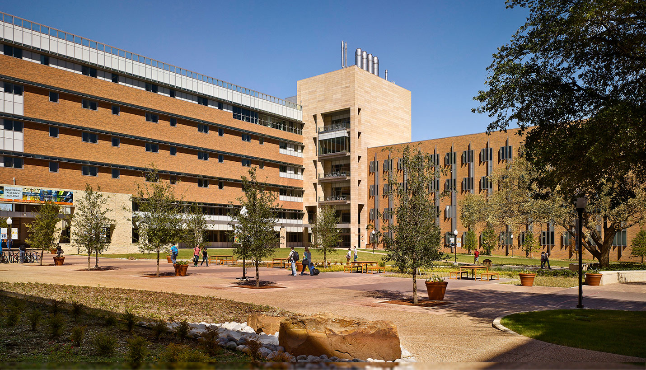
Academic
Experience
B.S to Ph. D
Quantitative Biology
University of Texas at Arlington.
Tier 1 Research University*.

Slide 9
As an Integrated Ph. D. candidate what do I do?
S .No | Responsibilities | Time*
1. | Research | 70%
2. | Teaching | 5%
3. | Grading | 10%
4. | Others (Emails, Prep work for lab, quiz, exam duty etc.) | 15%
* 40 - 60 hour work week after 2nd year.

Slide 10
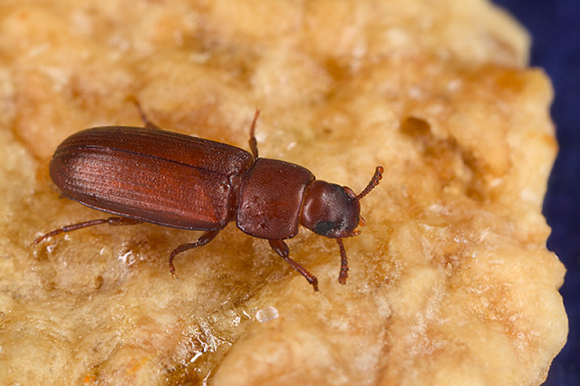
Research and Teaching
Research
Sex Chromosome Evolution.
Model System: Beetles (Wheat Flour Beetles)
Teaching
Cell and Molecular Biology
Evolution and Ecology
Tribolium castaneum

Slide 11
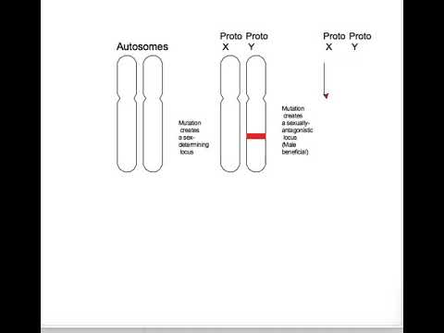
Brief Research Background

Slide 12

How do I spend my time in Research?
Read Primary Literature.
Do Experiments and Sequence DNA/RNA.
Write Programs to answer the research questions.

Slide 13
UG Research
S.No | What did I do? | Semester
4. | Research Project with Muthukumaran Sir. | 5th semester
5. | Research Project with Muthukumaran Sir and Sathish Sir. | 6th semester
6. | Bioinformatics Lab Technician? With Stephen Sir. Writing my first paper with Aravind Sir. | 7th semester
7. | UG Thesis: Pasteur Institute, Ooty. Advised by Sathish Sir and Stephen Sir. Recommended by Kumaresan Sir. | 8th semester
S.No | What did I do? | Semester
1. | Green Solutions (Internship) | 2nd semester
2. | GRE Class | 3rd semester
3. | Microcore Lab, Erode (Internship) | 4th semester

Slide 14
What did I learn from my UG projects?
Basic Microbiology and Molecular Biology Techniques.
Experience in Designing an experiment.
Data collection and Reproducible Results.
Data Analysis; Applying statistics to understand the results.
Drylab is something that I enjoy doing.

Slide 15
Technical Challenges

Slide 16
Challenges:
Suggested Solutions:
Self - Learning
Improve the depth of your knowledge in your field of interest.
Online-Courses.
Practice Solving Problems
Rosalind
Iterative Improvements.
Background in Evolution.
Background in Programming.
Formal Communication and Academic Writing.
Lecture and Presentation

Slide 17
What should you think about, before you decide to pursue a Ph. D. ?
Answer the big WHY.
That is, Why do you want to do a Ph. D. ?
Can you deal with constant failures?
Are you a person of grit and perseverance? - Link
Can you constantly read and update your knowledge on a specific field?
(Well, Technically)

Slide 18
Personal Challenges

Slide 19
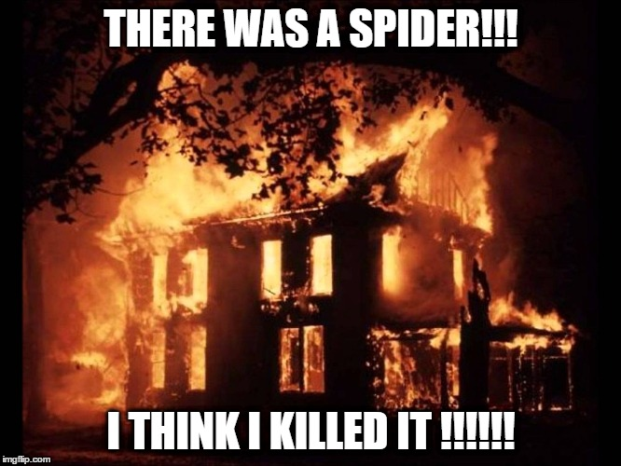
Challenges:
Vegetarian.
Cooking
Emotional Support System.
Living life as an “adult”.
Making Financial Decisions.
Doing Laundry.
Cleaning.

Slide 20
What should you think about, before you decide to pursue a Ph. D. ?
Can you live alone?
Can you manage your “adult” life?
Do you know how to balance your life?
Can you deal with FOMO?
All other philosophical questions that you can think of.
(Personally)

Slide 21
Summary

Slide 22
Ph. D is not easy and so is everything. But Can or Should you do a Ph. D.?

Slide 23
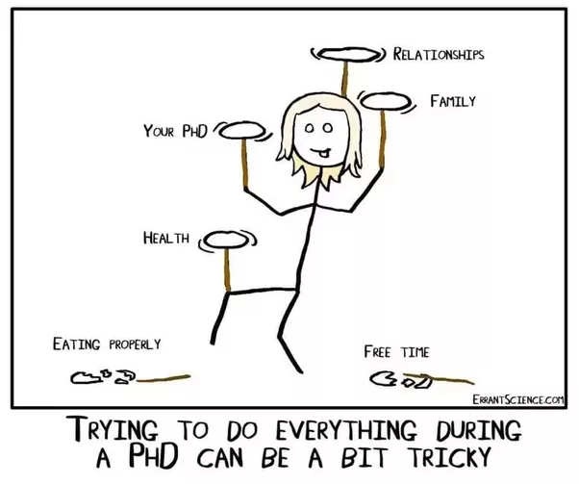
Think really carefully.
Then think again.
Source: https://qph.fs.quoracdn.net/main-qimg-4470d296cea49408f738db8653aa055a

Slide 24
Thanks for
listening!
Contact:
Email: yugendrabalan [at] gmail [dot] com
Website: rameshbalan.github.io

